Slide 1
Android TV
Thomas Belk

Slide 2
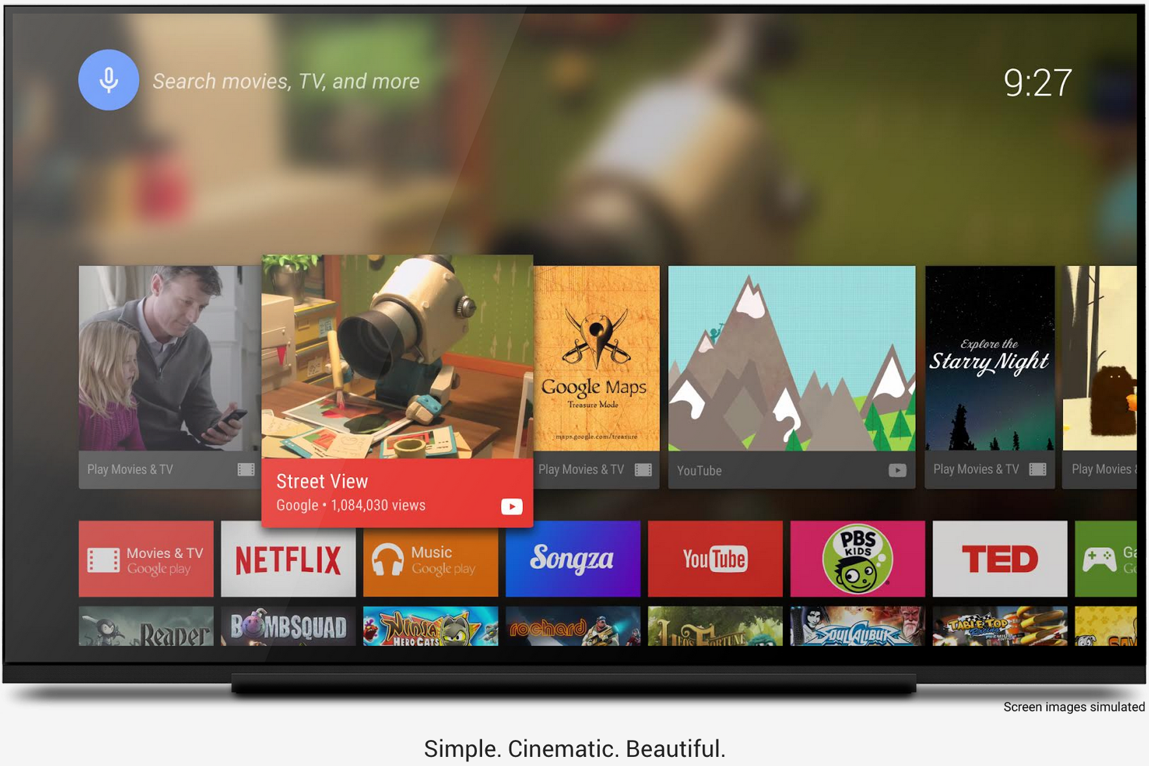
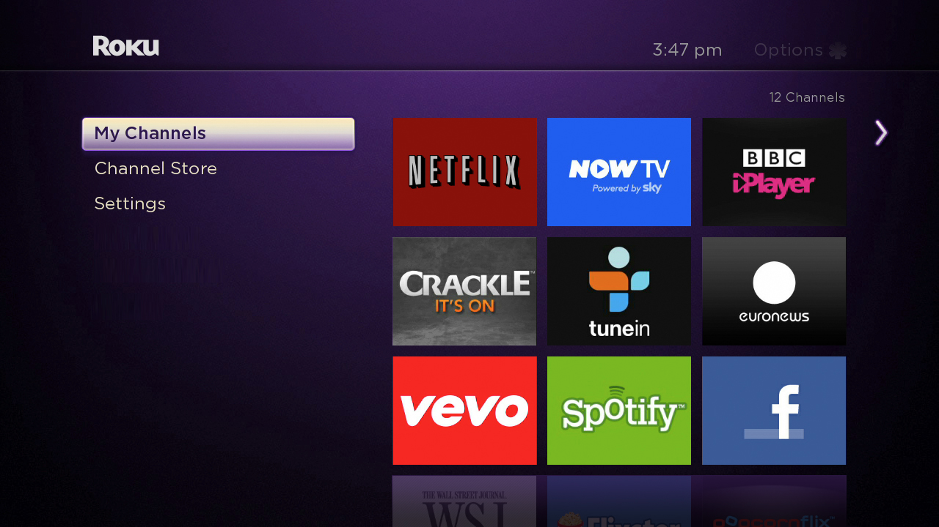
Overview
"Android TV is Android, optimized for the living room consumption experience on a TV screen"
Notes:
This is a quote directly from Google
Android TV is exactly that, its Android that uses a new support library for enhanced user views with more cinematic experiences.
Interactions are fluid, intuitive and fast
Very similar to what some entertainment apps already use on mobile phones, such as Netflix & Roku. You can see in the picture the ‘ribbon’ type view, similar to Netflix & Roku, Android TV makes heavy use of. As an example you can see the image on the right is from a Roku user interface.

Slide 3

About
Runs Android 5.0
Announced on June 25, 2014, at Google I/O
Supports Google Cast
Removed packages with functionality for:
making/receiving calls
the camera
near-field communication
Partnering with manufactures to bundle the slimmed OS in TVs
Notes:
Runs Android 5.0, Lollipop
Announced at Google I/O
Supports Google Cast, which is the technology behind the Chromecast media player
The verge reported that Google has removed touchscreen support, but I’m not sure if that’s true as some ‘TV’s’, likely monitors, can still provide touch screen interactions.
Google is partnering with a few TV manufactures to package the slimmed lollipop OS in TVs coming 2015

Slide 4
Specifications
ADT-1
Trega 4/Trega K1
2GB of RAM
16GB of storage
Bluetooth 4.0
HDMI
Wifi ready
USB port
Nexus Player
Intel Atom
1GB of RAM
8GB of storage
Bluetooth 4.1
HDMI
Wifi Ready
USB port
Notes:
Announced at Google I/O. Shortly after developers could register for a lottery in which they could receive the ADT-1 early version of the device
The ADT-1 was the early version of the device, it features those specs. It’s worth noting that some got the Trega 4 chip while others have the K1. The Trega 4 is a 1.8GHz quad core while the K1 is a 2.2GHz quad core.
The first consumer market ready Android TV device is the Nexus Player. It’s worth noting it has less RAM, less storage, but a slightly faster processor although the clock speed wouldn’t suggest it; 1.8GHz quad core.

Slide 5
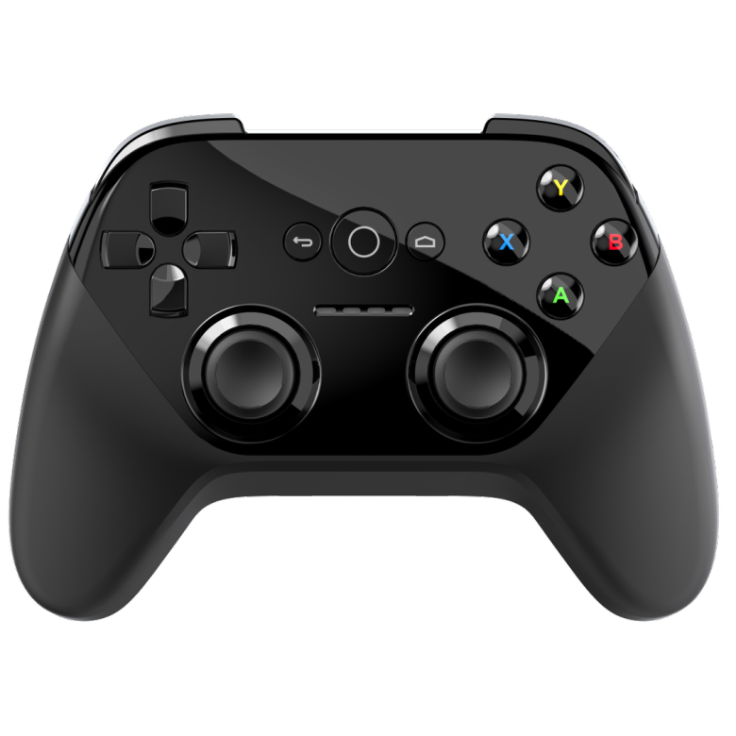
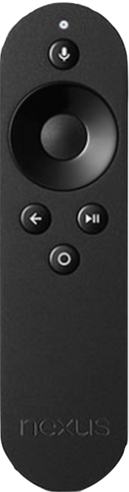
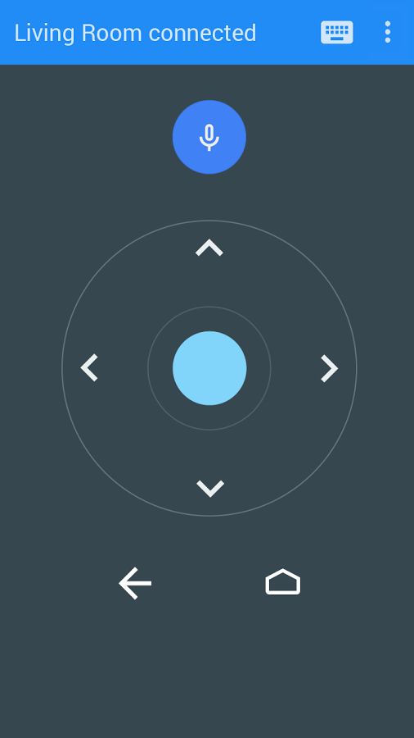
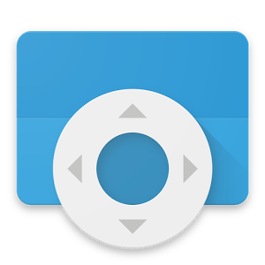
Controllers
Gamepad Controller
Remote
Notes:
There are two general types of controllers, one is the game pad controller which I’ll discuss more about later and the other is the remote, which gets packaged with the TV if you buy it from the Google play store now.
There’s a sudo 2.5 controller which is your phone. By downloading the Google build app called ‘Android TV Remote Control’ you get the same functionality of the remote on you phone.
This remote control app will pair with your device, just like a device that detects a chromecast. You will then need to enter a 4 digit pin code. Interaction with the TV’s interfaces is pretty simple beyond that point.

Slide 6
SDK Setup
Notes:
Recommended installs:

Slide 7
Emulator Setup

Slide 8
Leanback : Do the rockaway
“This song is all about Terror Squad being too cool to dance” – genius.com
Came out in 2004 by the Terror Squad
Questionable lyrics
Popular when I was in high school
Form your own opinions
Notes:
enough said…

Slide 9
Leanback Library
Provides new APIs and widgets to support building user interfaces on TV devices. Including:
BrowseFragment
DetailsFragment
PlaybackOverlayFragment
SearchFragment
Notes:
Leanback library was created to provide support and helpful widgets when creating Android TV applications
BrowseFragment - A fragment for creating a primary layout for browsing categories and rows of media items.
DetailsFragment - A wrapper fragment for Leanback details screens.
PlaybackOverlayFragment - A subclass of DetailsFragment for displaying playback controls and related content. I won’t be covering this with my project.
SearchFragment - A fragment to handle searches. The fragment receives the user's search request and passes it to the application-provided SearchResultProvider. The SearchResultProvider returns the search results to theSearchFragment, which renders them into a RowsFragment.

Slide 10
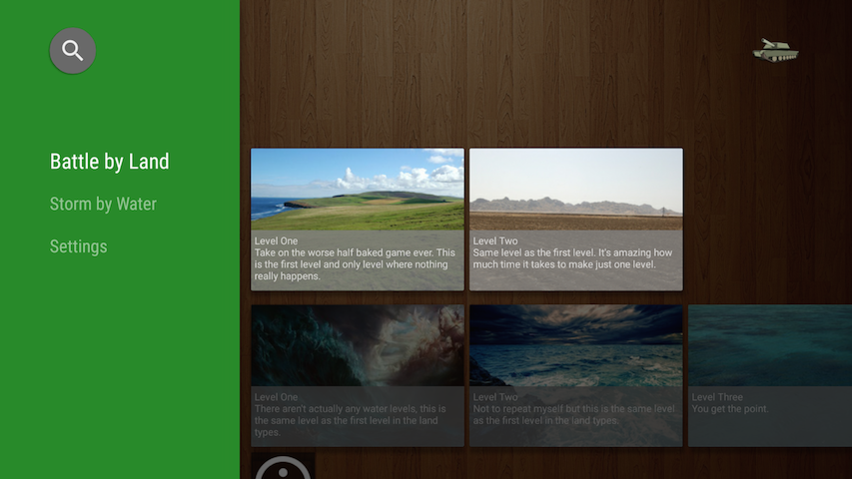
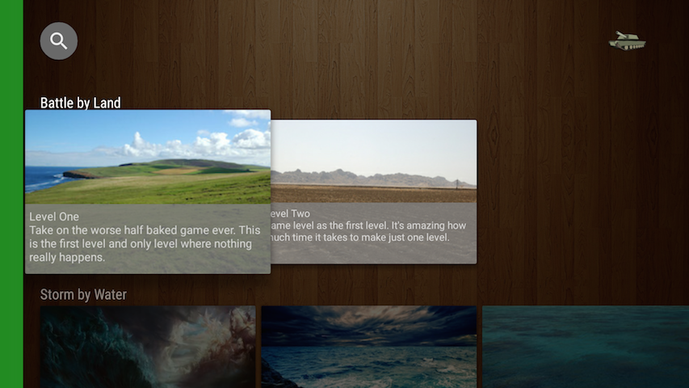
BrowseFragment
Notes:
BrowseFragment - A fragment for creating a primary layout for browsing categories and rows of media items.
I like to think of this as the menu of your TV application.
On the left side of the screen is a listing of categories, on the right the list of selectable items within the highlighted category
When you navigate to the right from the list of categories, the category drawer collapses to reveal a focus on your selectable items

Slide 11
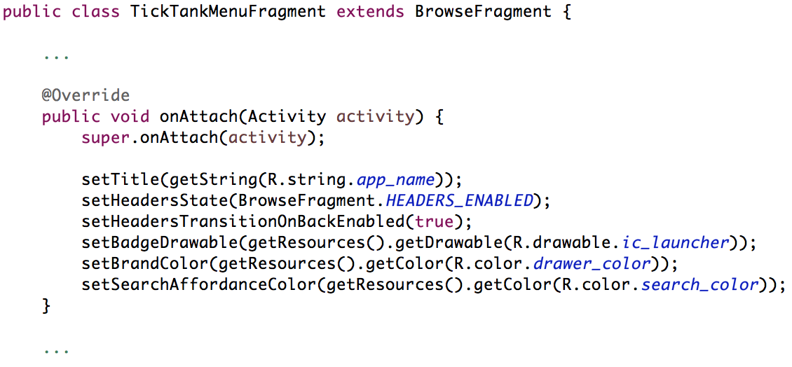
BrowseFragment
Extend BrowseFragment, calling any necessary UI convenience methods
Notes:
There isn’t a decent amount of coding that goes into extending and customizing the BrowseFragment
Steps:
Extend BrowseFragment
Use the ‘necessary’ convenience methods provided by new fragment, such as the brand color, search icon color, allowing headers (categories)

Slide 12
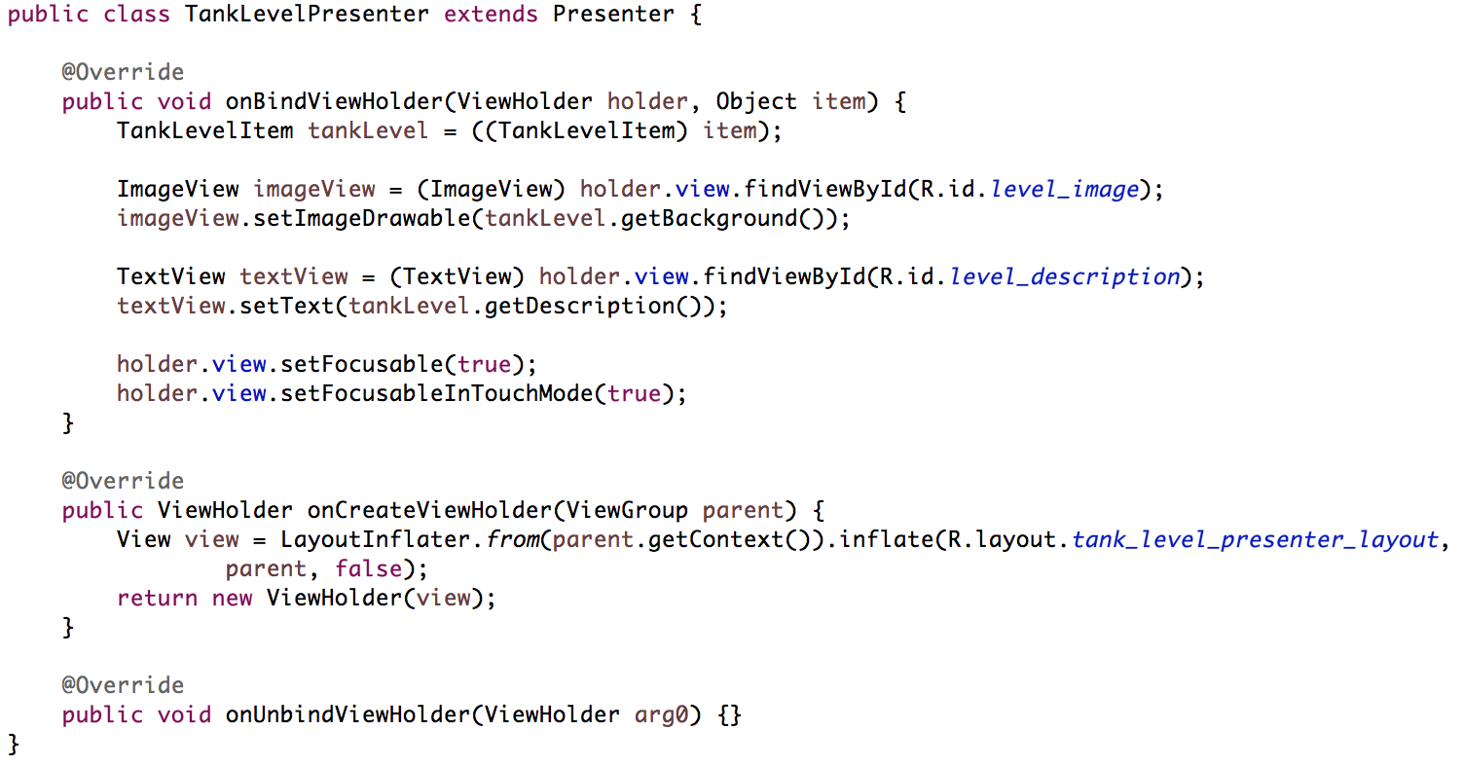
BrowseFragment
Extend Presenter
Notes:
BrowseFragment uses a presenter/adapter pattern to display information. The presenter structure is a mix between view holder for recycler views and recycler view adapters. I say this because the presenter is responsible for both inflating its view, holding the view, and finally populating it but is NOT the adapter for the list.
Create a Presenter for your information.
TankLevelItem is a POJO (Plain Old Java Object) with two fields. One is a String and the other a Drawable.
Note: if you don’t set your view to focusable the user will not be able to select it

Slide 13
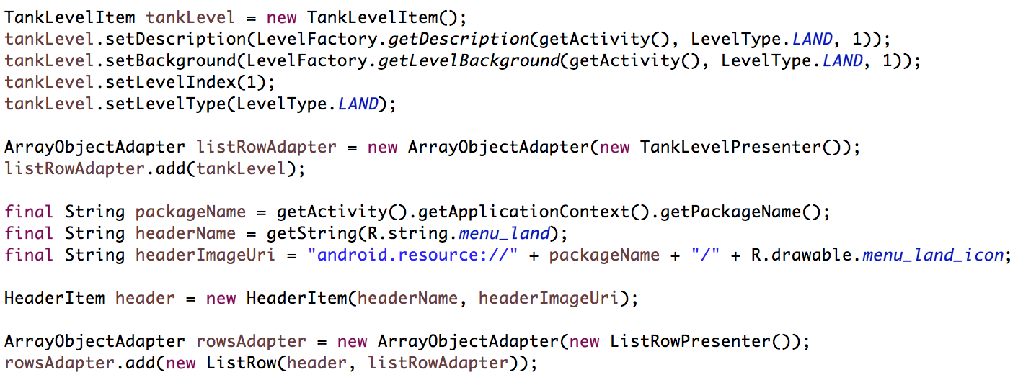
BrowseFragment
Populate the adapters
Notes:
We want to take the TankLevelItem POJO, set its attributes which will help customize the view, and add it to the adapter we’ve instantiated using our TankLevelPresenter.
The next step is creating a HeaderItem for the row. A HeaderItem is the category the selectable tank level is associated with.
It is important to note, you are able to set the image of the header row unfortunately there is a known bug with setting the resource uri of the image in the header item and the image not appearing
Finally we want to create a new list row with the header and our adapter. This list row will then get encapsulated into yet another adapter responsible for cycling threw rows in the list.
The reason we need two adapters is because one adapter will handle scrolling horizontally, while the other handles scrolling vertically.

Slide 14

BrowseFragment
Notes:
This slide is ugly because its so important you need to notice it and remember it.
You must call setAdapter in the BrowseFragment, passing in the adapter we’ve just created. If you don’t do this, nothing will show up!

Slide 15
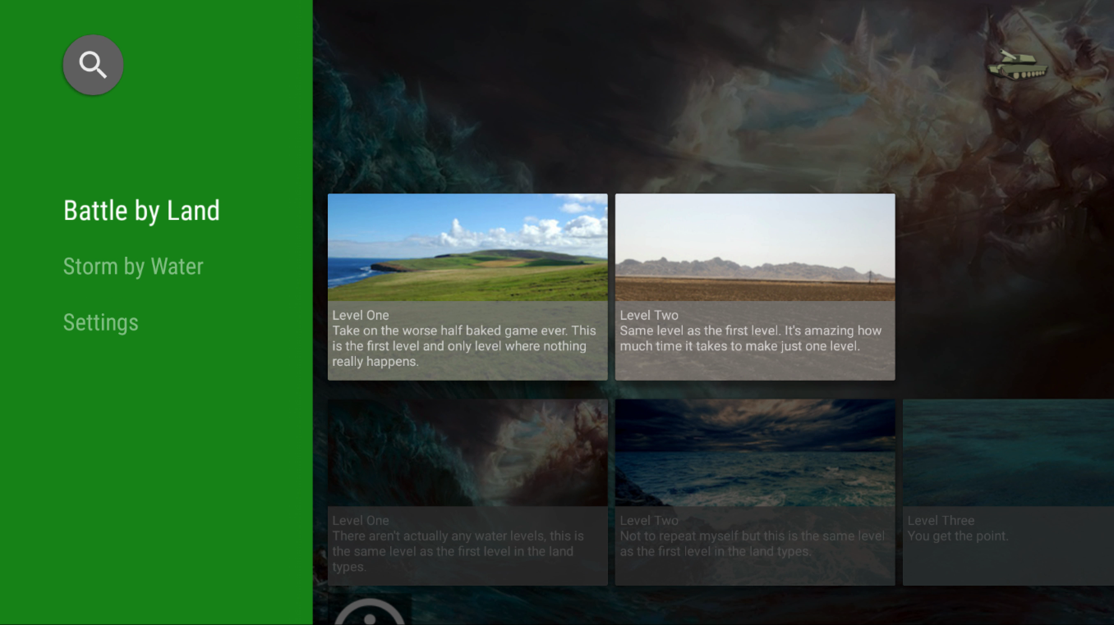
BrowseFragment

Slide 16
DetailsFragment

Slide 17
SearchFragment

Slide 18
Questions?
Thomas Belk
@yldsmith
github.com/wildsmith/TickTank

